Slide 1
Enhancing Users' Satisfaction in Libraries
by
Dr Sangeeta Kaul
Network Manager
DELNET-Developing Library Network
New Delhi
Email: sangs@delnet.ren.nic.in, sangskaul2003@yahoo.co.in

Slide 2
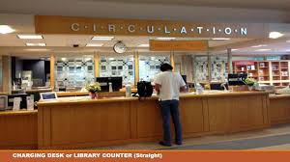
“A customer is the most important visitor on our premises, he is not dependent on us. We are dependent on him. He is not an interruption in our work. He is the purpose of it. He is not an outsider in our business. He is part of it. We are not doing him a favor by serving him. He is doing us a favor by giving us an opportunity to do so. “
Mahatma Gandhi

Slide 3
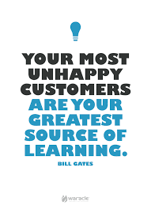
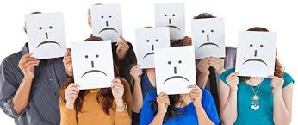

Slide 4
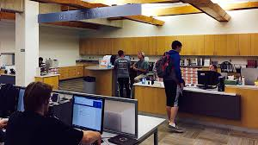
Get closer than ever to your customers. So close that you tell them what they need well before they realize it themselves. ~ Steve Jobs

Slide 5
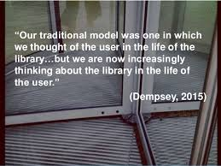

Slide 6
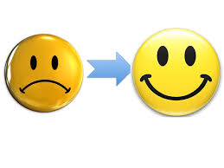

Customer Satisfaction

Slide 7
WAYS TO BOOST USERS’ SATISFACTION

Slide 8
MEETING THE NEEDS OF LIBRARY USERS
How do you ensure that you are meeting the library and information needs of the users and potential users of your library ?
By Instinct
Through Years of Experience

Slide 9
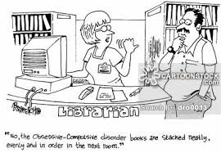

Slide 10
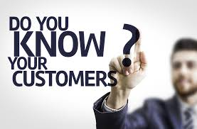

Slide 11
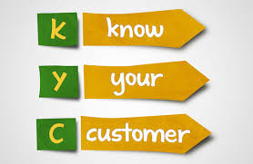
WAY 1 : KYC – KNOW YOUR CUSTOMER/USER
Kindly prepare a KYC form which should get filled up by a library user containing the details including the subject specialisation, allied areas of interest, hobbies, etc.

Slide 12
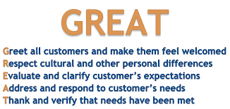
WAY 2: FEEL GREAT FACTOR

Slide 13
WAY 3 : PLEASING & REFERENCE STAFF AT FIRST POINT OF USER CONTACT IN A LIBRARY
According to a survey by OCLC :
The first point of contact in the library is the
person who is least paid
Physical qualities students seek !
The desk be staffed by friendly people
Have library hours that fit the lifestyle of your users.

Slide 14
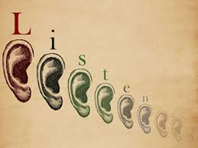
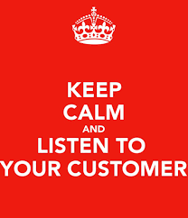
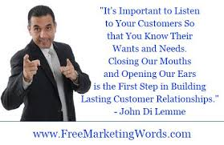
WAY 4 : LISTEN TO YOUR USERS & GET SPECIALISED IN ART OF LISTENING

Slide 15
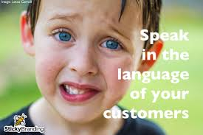
WAY 5 : YOU MUST SPEAK TO YOUR USER, ENHANCE THE VERBAL COMMUNICATION SKILLS
LAST
Listen
Apologise
Solve
Thank
Recreate the Library spaces from the “Silent Zones” to “Places of Interaction”

Slide 16
Way 6 : Be prompt in responding to written/verbal queries of the Users
Do respond proactively to the user’s queries, received through emails, phone calls, postal letters, etc.
Even if you may like to write again with a detailed reply, do kindly inform the user about it.
Silence is the biggest mystery of the World. Remain Communicative with your user community.

Slide 17
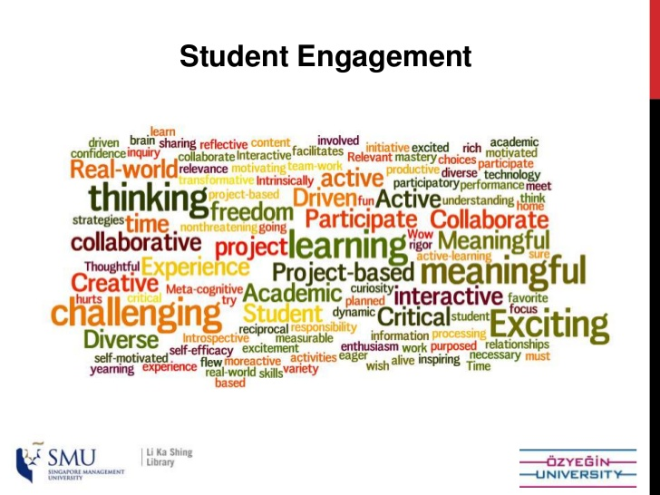
Way 7 : To devise User Engagement Strategies
The library must develop the “User Engagement Strategies” in order to engage the library users. The Users retention policies should be developed encouraging the users to visit libraries and to utilize the services and resources.
More engaged learners are more satisfied.

Slide 18
Way 8: Use of Social Media for enhancing Connection in Libraries
The library must make the best use of Social Media tools like Twitter, Facebook, Youtube, etc for enhancing connections with the Users community.
According to the recent T&F report on the use of Social Media in Libraries, overwhelming 88% of respondents to the survey felt that social media would become more important to the library in the future.

Slide 19
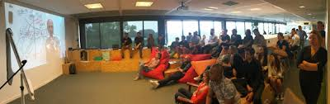
Way 9 : To conduct Remote/Offsite/Online Training Sessions for the Users’ & to organise Webinars
To facilitate anytime/anywhere training of the Library Users’ for using the Library Services – online databases, etc on their own personal devices. These sessions can be recorded and viewed again as per the convenience of the users.

Slide 20
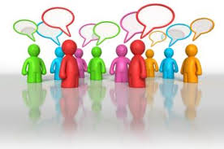
Way 10 : Develop User Driven Policies for Your Library
You must develop “User Driven Policies” for the Library and its users, rather than “Driving the Users Away”.
Do involve the library users’ community for their suggestions and inputs before finalising a policy meant to be implemented for them.

Slide 21

Way 11 : Build a Digital Reference Services to the Users
From the traditional Reference Services, the Libraries must develop the Digital Reference Services/Live Virtual Reference Services to the Users.
IFLA Digital Reference Guidelines is available at https://www.ifla.org/files/assets/reference-and-information-services/publications/ifla-digital-reference-guidelines-en.pdf

Slide 22

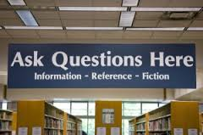
Way 12 : Introduce “ASK US” Service for the Library Users
Encourage the Users to Ask the Questions and to get replies to their queries

Slide 23
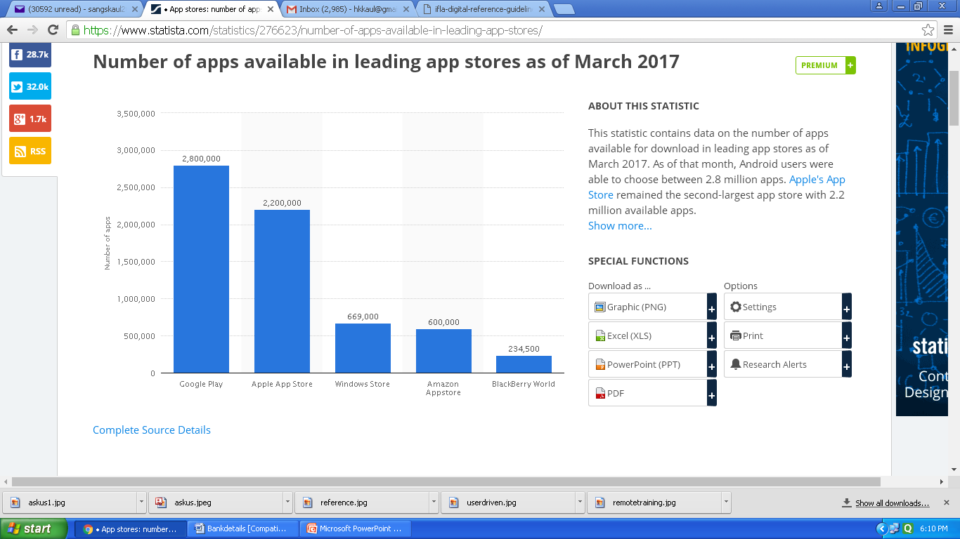
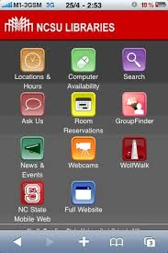
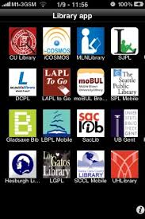
Way 13 : Appification of Library Services
The mobile apps be developed for various library services, facilities and resources which would facilitate a better utilisation by the library users. There are not many mobile apps for libraries available.

Slide 24
Way 14 : Develop Tools to Receive Feedback from the Users
Besides conducting surveys (online/manual), the mobile apps may be developed to receive quick feedback from the users. The bulk sms services are available now at much economical rates.

Slide 25
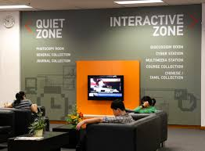
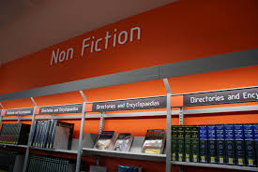

Way 15 : Use of Signages, Graphic Panels, etc in a Library
The library guiding, signages, display lighting, sign technology, graphic panels and branded library materials enhances the user experience. These are inexpensive ways which makes lasting impressions.
The main collection areas, the staff areas, the study areas can be marked distinctively with them.

Slide 26
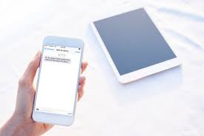
Way 16 : Personalised Value Added Services to Users
The Library needs to offer personalised services to its users on the specific areas of their interest on their own personal devices and also through email, etc. It may include delivery of e-articles, newspaper clippings, etc.

Slide 27

Way 17 : Library Services Alert
The library should introduce “Library Services Alert” which may include information about the forthcoming library events, subscription to new resources, conferences in a particular subject discipline, etc. These alerts can be sent either through mobile or through emails.

Slide 28
Ways 18 : Online Recommendation System for adding a new item in a Library collection
The Library should introduce the “Online Recommendation System” for its bonafide users to suggest for a new item (book, journal, etc) to be added to the library collection. This would help in collection development. The link can be created on a library portal and a simple email can be sent to the Librarian by the user.

Slide 29
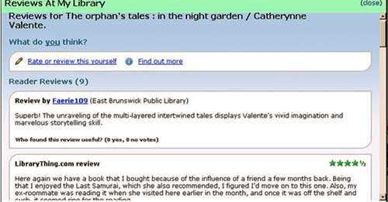
Way 19 : Integration of Catalogued records with Feedback, Rating, Recommendation Features
There is a need to integrate the features for offering users’ feedback, rating and the option to recommend the book from the catalogued online records of a library. It will inspire the resource discovery .

Slide 30
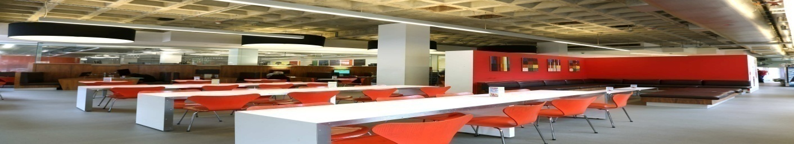
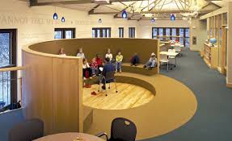
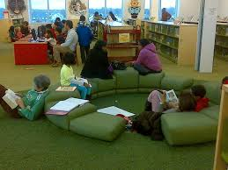
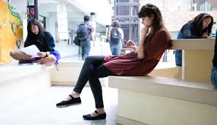
S
Way 20 : Redesigning Library Spaces
Makerspaces (Experimentation Labs), Recording Studios, Interaction Halls, Library Cafes

Slide 31


Way 21 : Creation of Blogs, Wikipedias
The Library must take an initiative to create Blogs and Wikipedias on the subjects of interest involving the users (Students, Faculty members). This would lead to knowledge sharing. A specific library staff should be assigned the work for coordination and content writing.
Library should also create its own library blog.

Slide 32
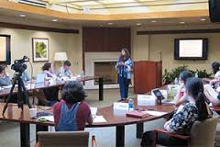
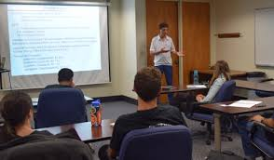
Way 22 : Faculty/Students Interaction Meet
Library should hold Faculty/Students interaction meet in order to enhance better learning and to know about the gap areas in content delivery wherein library can play a role.

Slide 33
Way 23 : To hold special talks, training on varied subject areas for targeted user’s community
The Library, epicentre of connections, must organise special talks, sessions on topics of varied interest including Career Counselling, soft skills training for the students, and other subjects on which the users may feel interested to attend.
The KYC details will be helpful in deciding about the topics in which the users are interested in to attend. The intimation should be sent to the specified users only

Slide 34
Way 24 : Facilitate the Best Library Users
The Library should encourage the best use of library services and must organise events to facilitate the best library users who have taken the maximum books in a year, the user who has walked into the library maximum number of times during a year. A small get-together can be organised and on such a occasion a talk, presentation from an invited speaker can also be held.

Slide 35
Way 25 : Implement ISO for Users’ Satisfaction in Libraries
The Libraries should implement ISO 9001: Customer satisfaction 8.2.1
It will ensure that the adequate measures are taken to ensure the customer satisfaction.
It will be a policy document which will enable the library manpower to practice it in every sphere of their services in a library environment.

Slide 36
Acknowledgements
Photo Courtesy : googleimages

Slide 37
SUGGESTIONS FROM DELEGATES FOR BOOSTING USERS’ SATISFACTION IN LIBRARIES

Slide 38
Arise, Awake and Stop not
Till the Goal is Reached
Swami Vivekanand

Slide 39
LET US TAKE A PLEDGE
TO WORK
NOT ONLY FOR
USERS’ SATISFACTION
BUT ALSO FOR
USERS’ DELIGHT !

Slide 40
Thanks for your attention and inputs
for making it an interactive session !

